Slide 1
Red bus Scraping with Selenium & Dynamic Filtering using streamlit

Slide 2
Table of Contents
Project Overview
Required Tools
Python Libraries
Data Scraping
Data Storage
Database Schema
Streamlit Application
Data Analysis/Filtering using Streamlit

Slide 3
Project Overview
Objective:
This project uses Selenium to scrape bus route data from the Redbus website and presents it in an interactive, user-friendly Streamlit web application. Users can filter and analyse the data to make informed travel decisions.
Source:
Data will be scraped from the Redbus website.
Link- https://www.redbus.in/
Streamlit App:
Customized Streamlit App using SQL for user-friendly and quick results.

Slide 4
Required Tools
Anaconda Jupyter Notebook
Visual Studio
Programming Language – Python 3.8 or higher
Selenium WebDriver
Streamlit
Google Chrome / Any web browser
SQL Database – MySQL / Any Database
GitHub

Slide 5
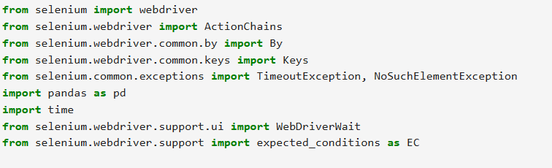
Python Libraries

Slide 6
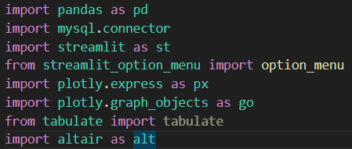
Python Libraries

Slide 7
Data Scraping
Selenium:
Selenium is an open-source framework for automating web browsers, allowing users to simulate user interactions and test web applications.
It supports multiple programming languages, including Python and Java, and works with various browsers like Chrome, Firefox, and Safari.
Selenium WebDriver, its core component, interacts with web elements and performs actions such as clicks and form submissions.
It’s widely used for functional testing and can integrate with tools for continuous integration and reporting.

Slide 8
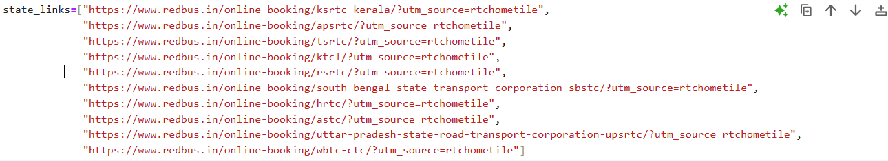
Selenium Coding
Step 1
We need to take the 10 states link as per the project requirement

Slide 9
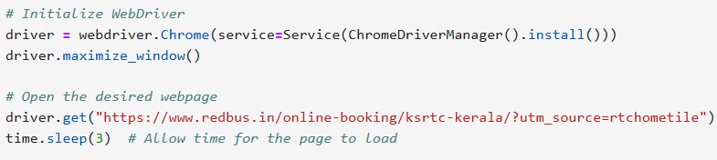
Selenium Coding
Step 2
Initiate the webdriver with Chrome() method(as we are using Chrome web browser). We get the url details by get() method. Time lapse is given because we are giving time for the page to be loaded.

Slide 10
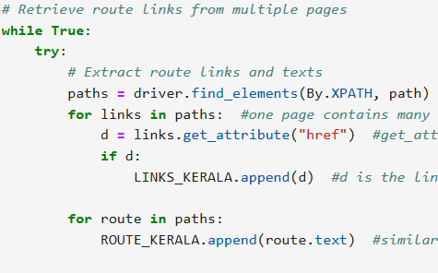
Selenium Coding
Step 3
We retrieve the route names and route links for each state.
There is a page button we trigger that using (find_element method) which is an in-built to retrieve the elements using different tags in page source.

Slide 11
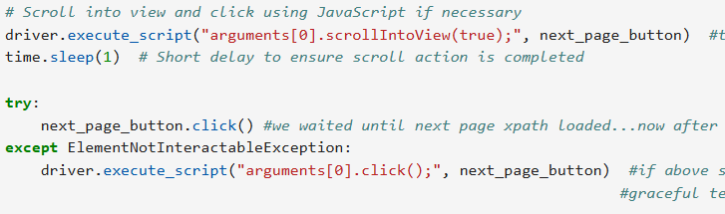
Selenium Coding
Step 4
By looping inside each link all the other bus details are retrieved. For that we use scrolling method to scroll to the end of the page automatically.

Slide 12
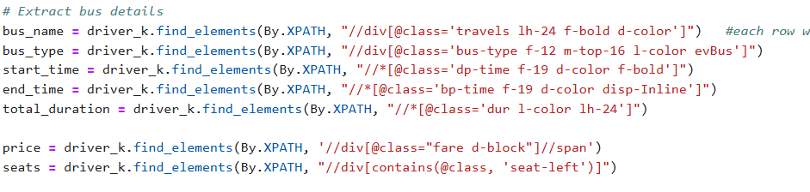
Selenium Coding
Step 5
Uses find_elements to locate elements on the page containing bus details such as name, type, departure and arrival times, duration, price, available seats, and ratings using XPath.

Slide 13
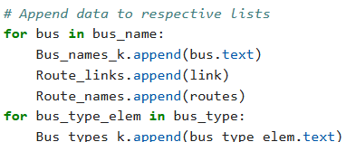
Selenium Coding
Step 6
Extracts the text attribute of each element and appends it to the respective list.
Links and route names are appended in parallel to maintain consistency.

Slide 14
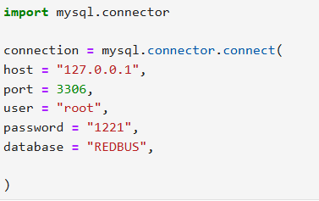
Data Storage
Connect to your database(MySQL).
Create a database in Database tool.

Slide 15
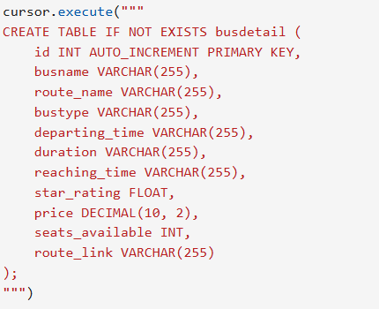
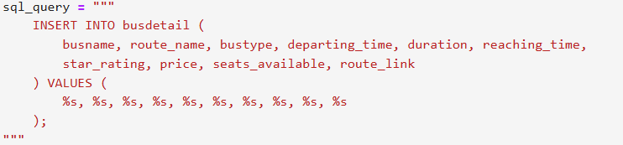
Database Schema
We create a table and insert values into the Database

Slide 16
Streamlit Application
Streamlit is an open-source framework that simplifies the creation of interactive web applications for data science and machine learning projects.
It allows users to build apps quickly using Python code with minimal setup, focusing on visualizing data and deploying machine learning models.
Streamlit applications are highly customizable and provide real-time interactivity, enabling users to explore data dynamically.
It integrates seamlessly with popular data libraries like Pandas and Matplotlib, making it an ideal tool for rapid prototyping and sharing insights.

Slide 17
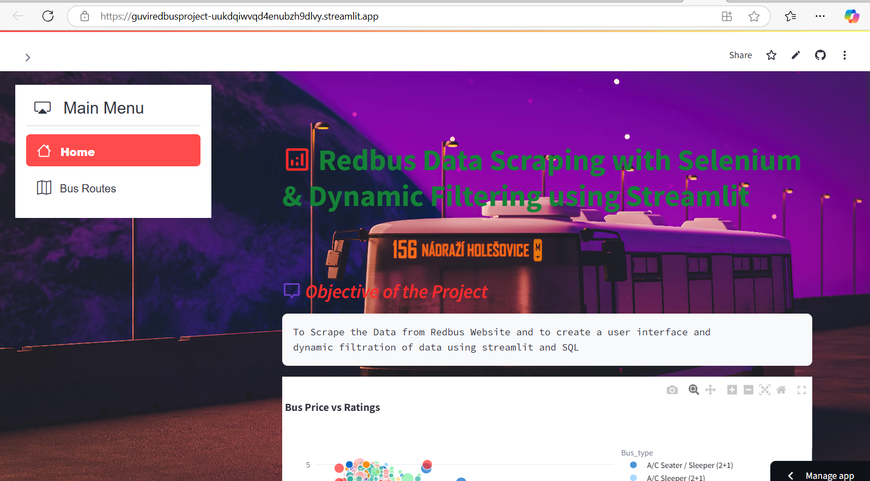
Application with data filtering – screenshot 1

Slide 18
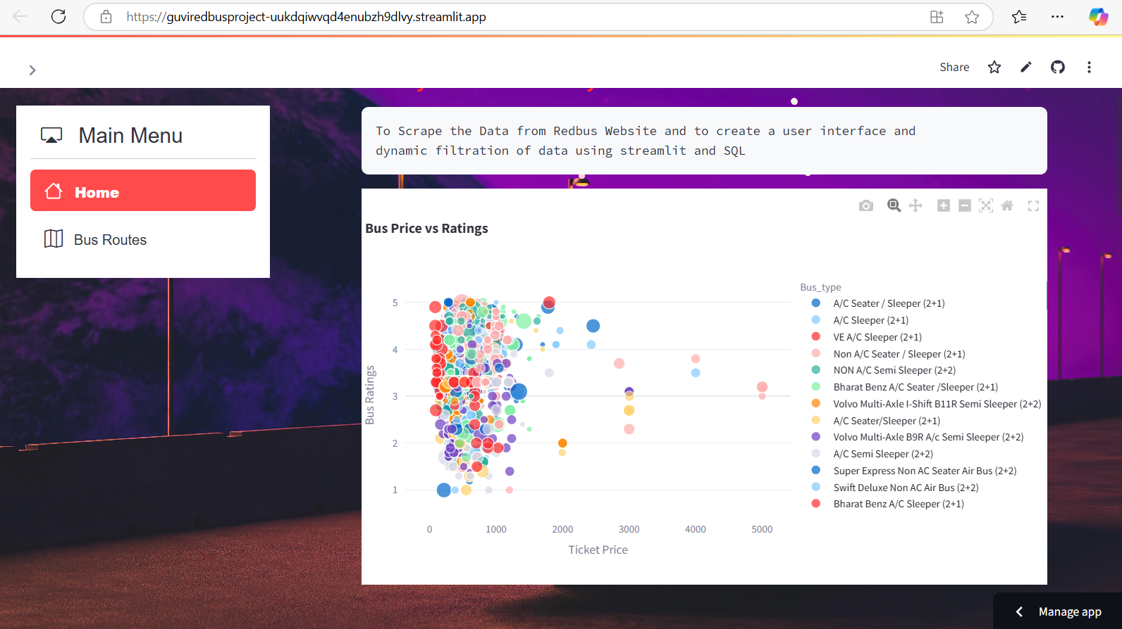
Application with data filtering – screenshot 2

Slide 19
Application with data filtering – screenshot 3

Slide 20
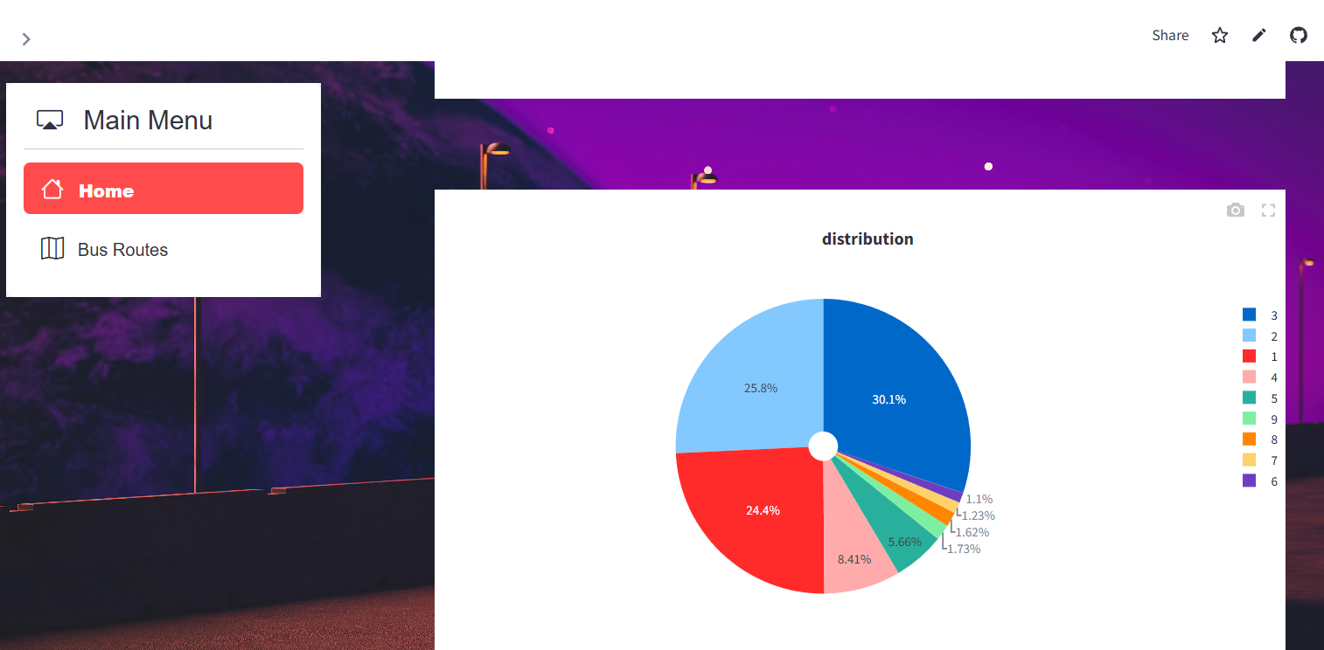
Application with data filtering – screenshot 4

Slide 21
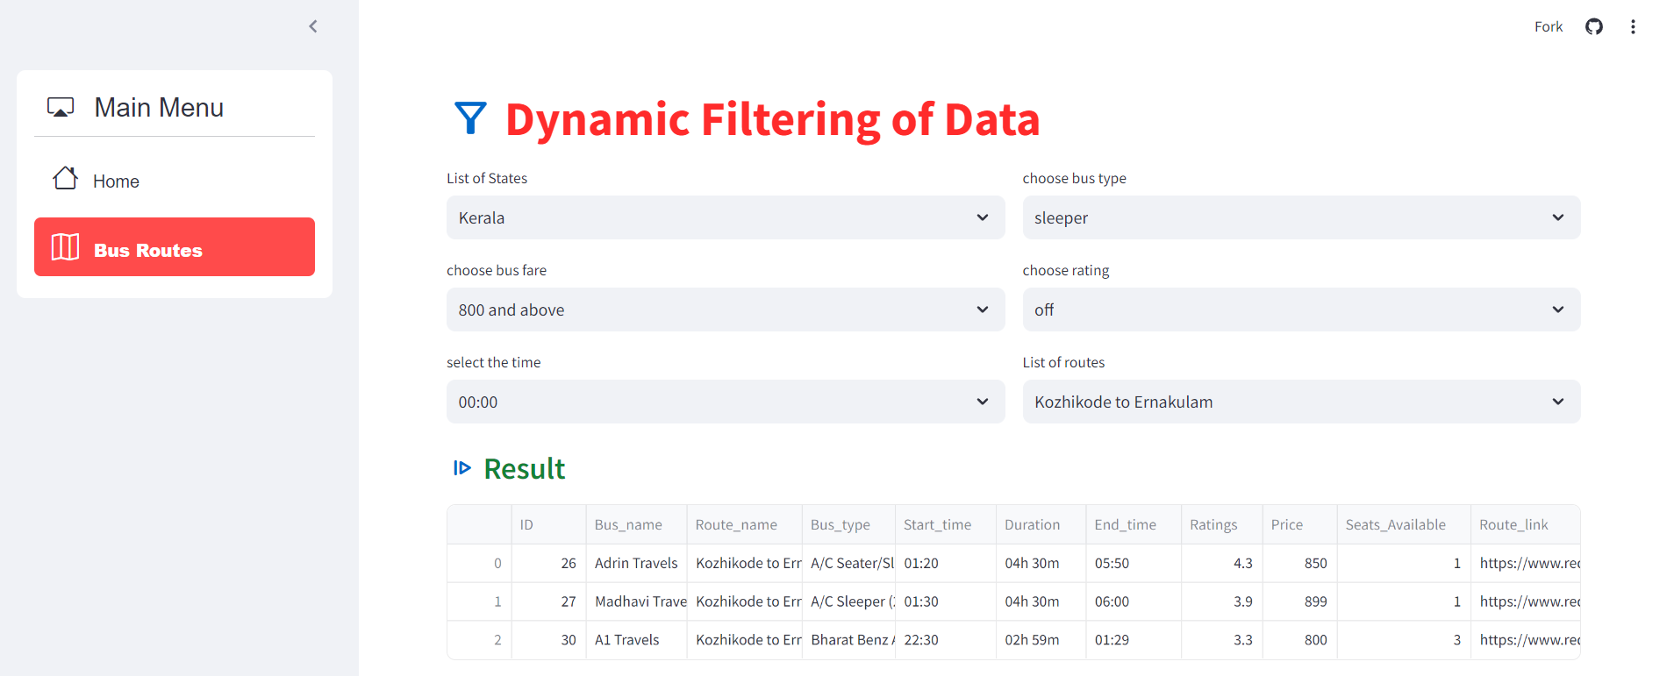
Application with data filtering – screenshot 5

Slide 22
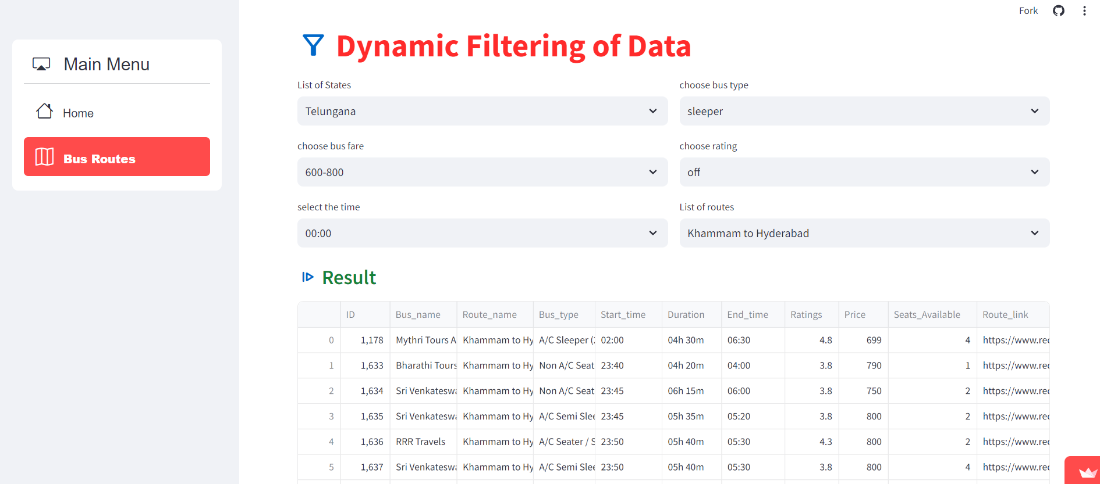
Application with data filtering – screenshot 6

Slide 23
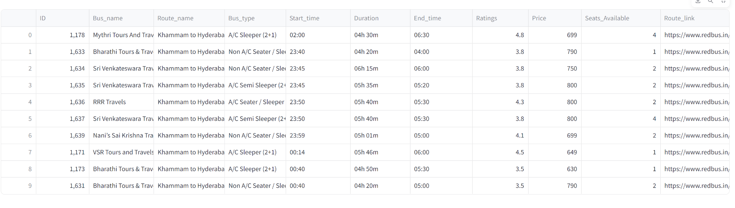
Application with data filtering – screenshot 7

Slide 24


